Slide 1
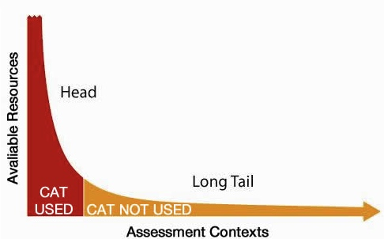

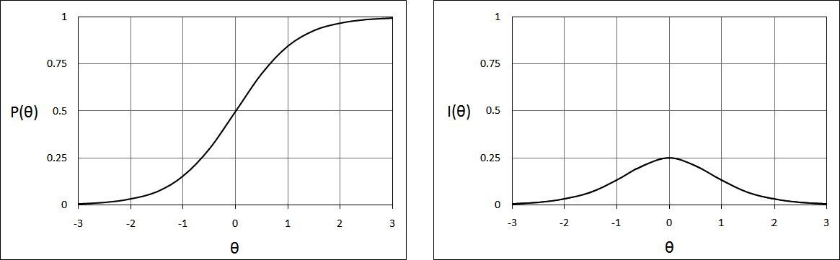
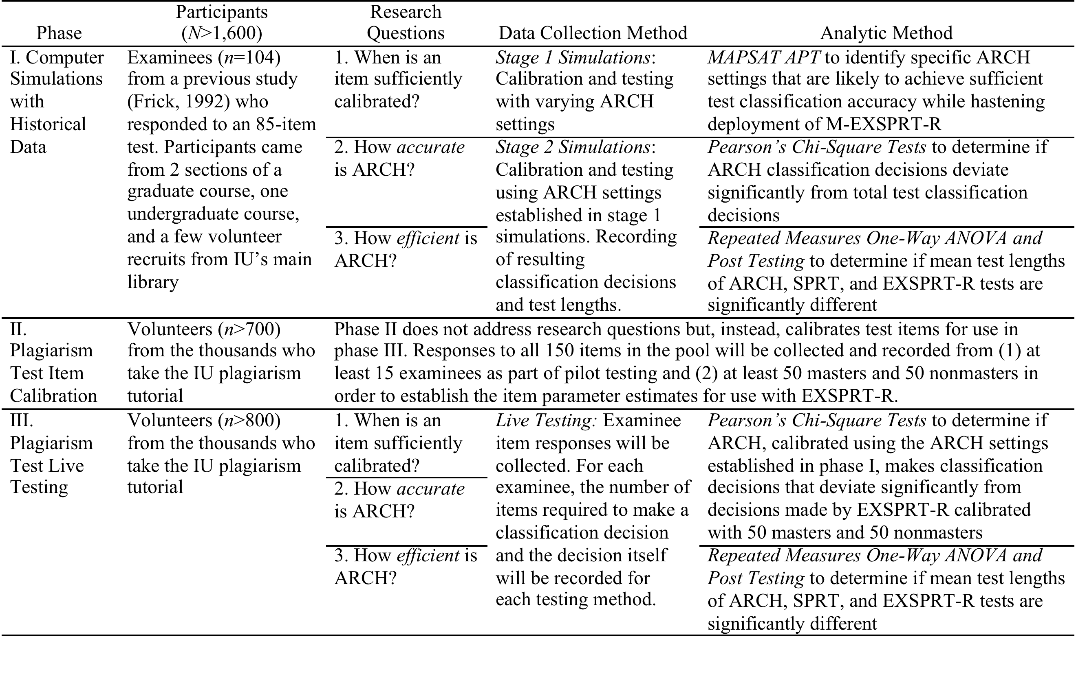
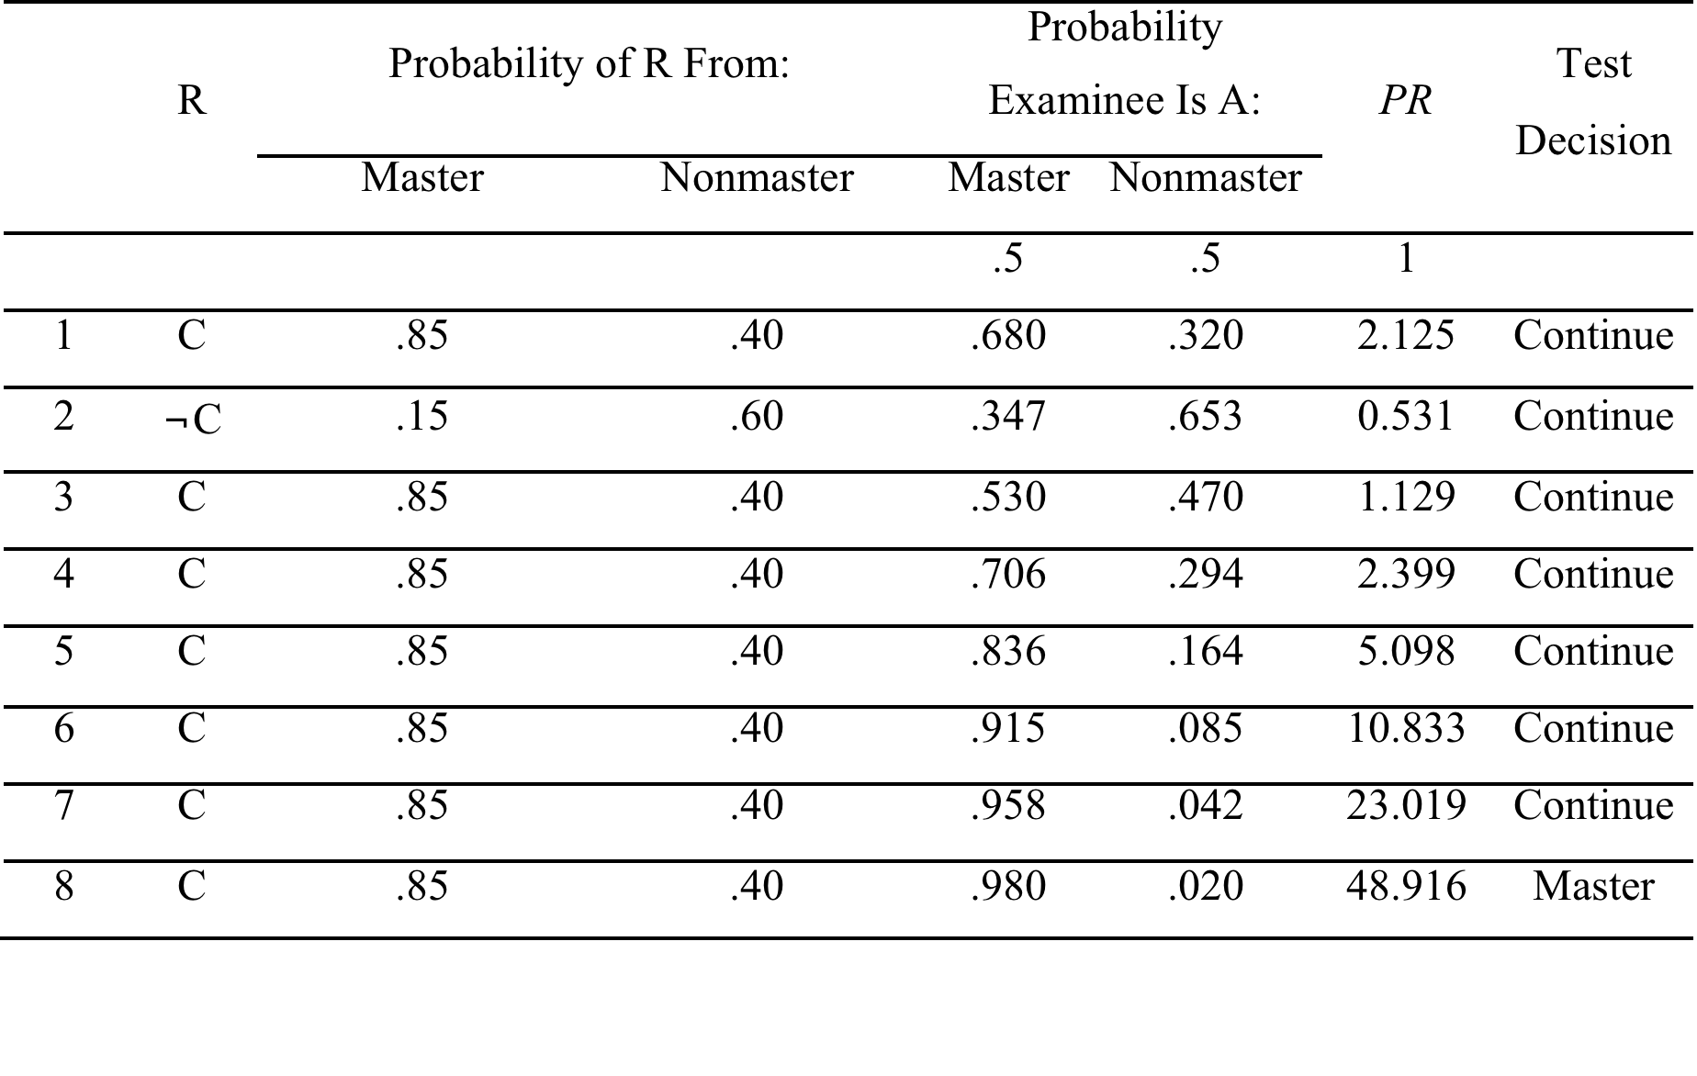
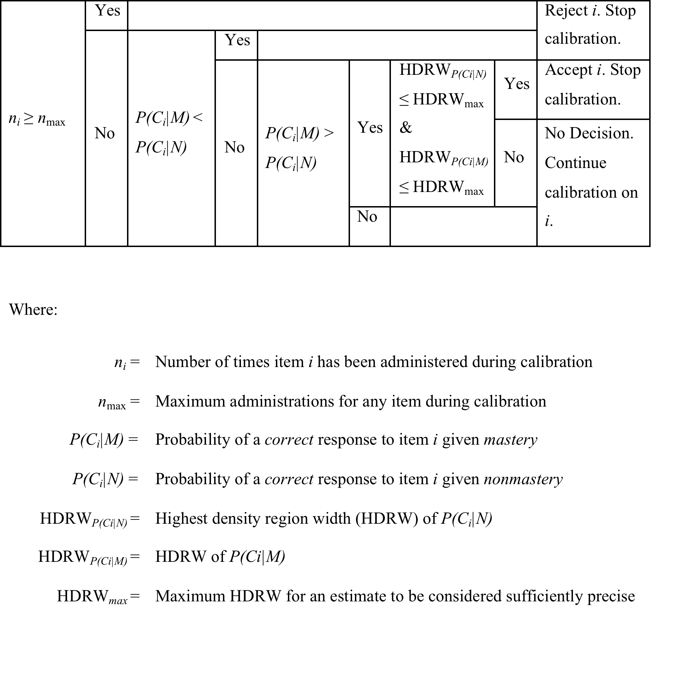
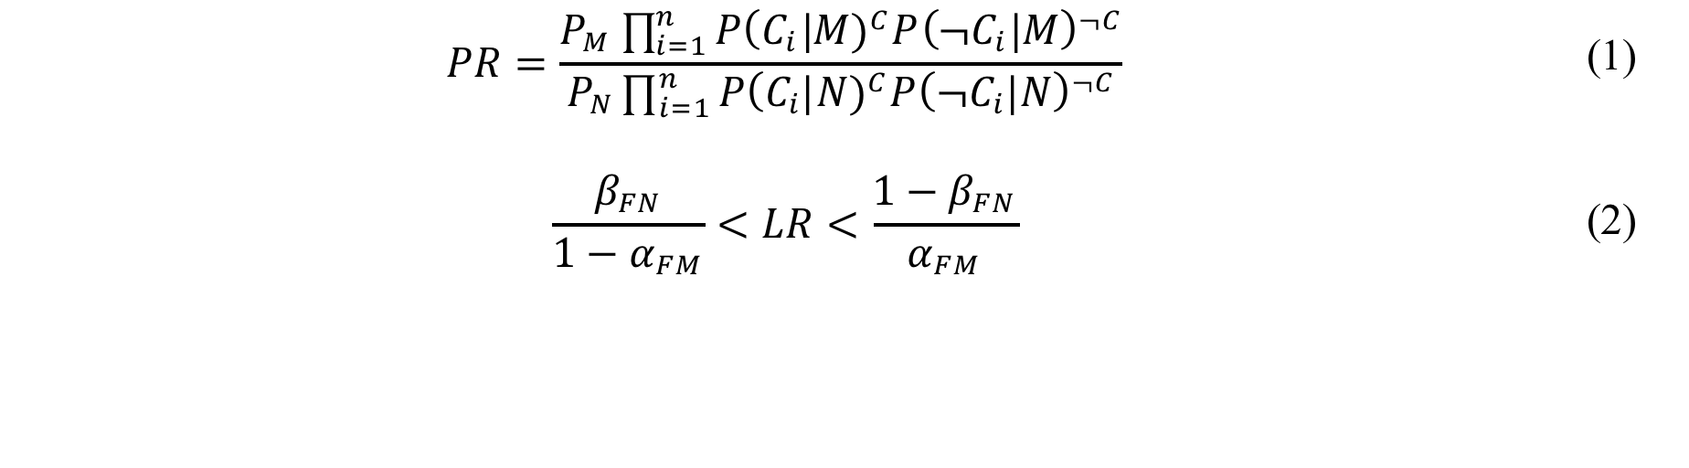
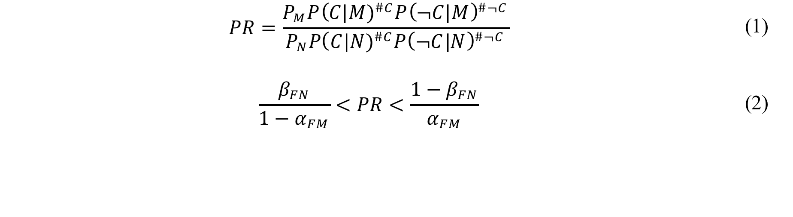
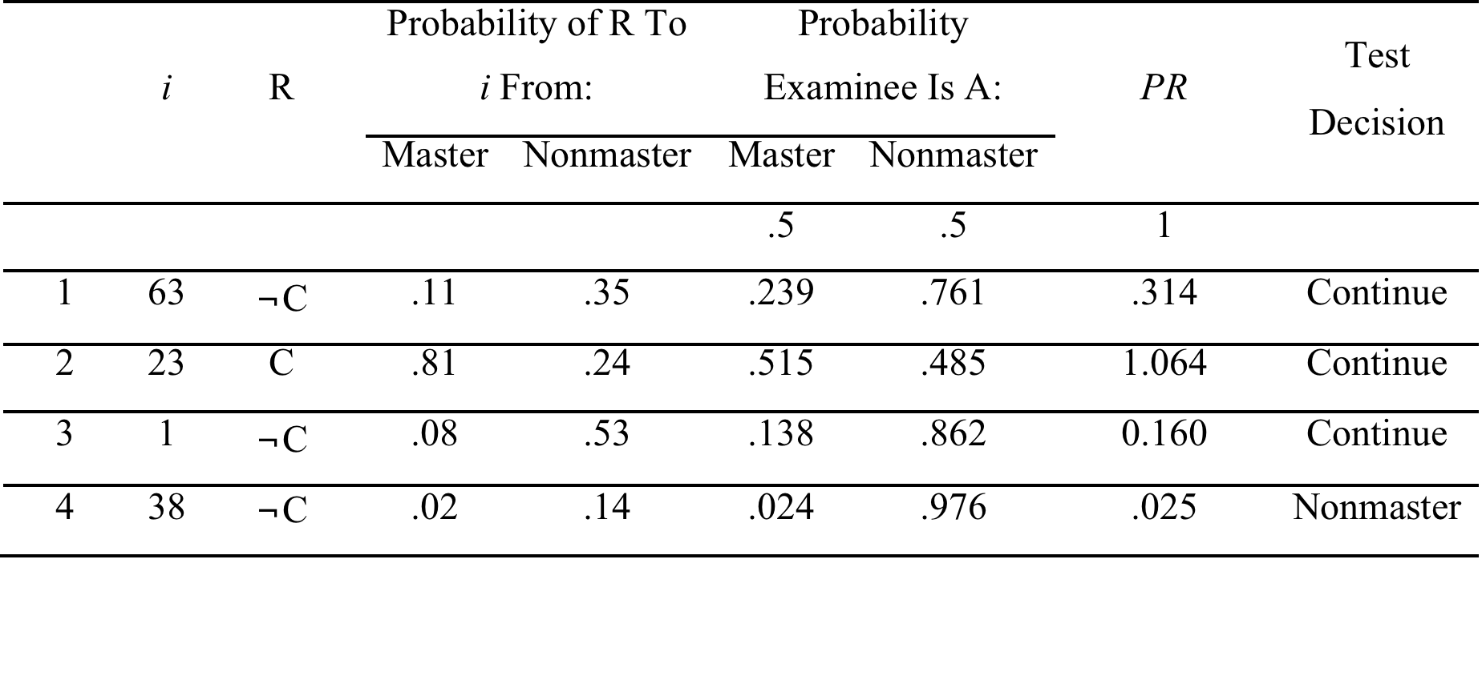
ARCH: Bridging the Divide Between Assessment Practice in Low & High-Stakes Contexts
Andrew F. Barrett & Dr. Theodore W. Frick
Department of Instructional Systems Technology, School of Education, Indiana University Bloomington
ITEM CALIBRATION BURDEN HINDERS CAT ADOPTION
ARCH FOUNDATIONS
ARCH APPROACH TO ITEM CALIBRATION
EXAMPLE
ARCH RESEARCH
PROBLEMS WITH CAT
Heavy resources requirements of item calibration can make CAT impractical in all but a few large-scale, high-stakes, and/or highly profitable contexts
The long tail of assessment in lower stakes contexts could benefit from CAT
SPRT
The Sequential Probability Ratio Test uses item-bank level probabilities & responses to randomly selected items to make classification decisions.
Phase I: Test re-enactments via computer simulations using historical test data from a previous study (Frick, 1992). ARCH settings needed for accurate testing established in phase I will be used in phase III.
Phase II: Pilot test & calibrate test items created for a new version of the online test used by Indiana University’s plagiarism tutorial available at https://www.indiana.edu/~istd
Phase III: Live testing with the new version of the plagiarism test.
Participants: Phase II & III participants will be recruited from the thousands of individuals who take the Indiana University plagiarism tutorial.
ARCH
Automatic Racing Calibration Heuristics uses statistical hypothesis testing to address item calibration. In ARCH, SPRT is pitted against
CAT depends on an item bank & specific information about items established during item calibration
Calibration can involve gathering responses from hundreds or thousands before the item can be used
Large motivational differences exist between examinees who participate in item calibration, an often low or no stakes context, & actual test examinees (Wise & DeMars, 2006 in Makransky, 2010)
Not Fully Calibrated M-EXSPRT-R Still Beats SPRT
Start with an item-bank calibrated for use with SPRT
      P(C|M) = .85 P(C|N) = .40
      P(¬C|M) = .15 P(¬C|N) = .60
ARCH approach has sufficiently calibrated items 63, 23, 1, & 38 for use with M-EXSPRT-R
After 7 randomly administered items, only M-EXSPRT-R is able to make a decision despite not being able to use 3/7 of the responses
SPRT & M-EXSPRT-R are able to use the responses to items 63 & 23 to calculate corresponding probability & likelihood ratios
Only SPRT can use the item 28 response to update the probability ratio, M-EXSPRT-R does not yet know enough about item 28
Items 28, 87, & 11 have not yet met calibration heuristics criteria & have been neither accepted nor rejected for use by M-EXSPRT-R
M-EXSPRT-R in a race to make accurate classification decisions about examinees. Initially, only item-bank level parameter estimates for SPRT are available. M-EXSPRT-R must collect the data it needs during live testing.
After each classification, ARCH:
Automatically uses responses gathered during online testing to update calibration data for items
Uses heuristics (decision table below) to see if any items are sufficiently calibrated for use with M-EXSPRT-R
As testing continues, more items become sufficiently calibrated for M-EXSPRT-R which increases the chances that M-EXSPRT-R will be able to make classification decisions before SPRT. In other words, tests get smarter & shorter as data is collected.
EXSPRT-R
The EXSPRT-R (EX stands for EXpert & R stands for Random selection) ends once it’s confident in a particular decision.
REFERENCES
Frick, T. W. (1989). Bayesian adaptation during computer-based tests and computer-guided practice exercises. Journal of Educational Computing Research, 5(1), 89-114.
Frick, T. W. (1992). Computerized adaptive mastery tests as expert systems. Journal of Educational Computing Research, 8(2), 187-213.
Makransky, G., & Glas, C. A. W. (2010). Unproctored Internet Test Verification: Using Adaptive Confirmation Testing. Organizational Research Methods, 1094428110370715. doi:10.1177/1094428110370715
Rudner, L. M. (2009). Scoring and classifying examinees using measurement decision theory. Practical Assessment, Research & Evaluation, 14(8). Retrieved from http://pareonline.net/getvn.asp?v=14&n=8.
Stein, C., & Wald, A. (1947). Sequential confidence intervals for the mean of a normal distribution with known variance. The Annals of Mathematical Statistics, 427–433.
Thompson, N. A. (2007). A Practitioner’s guide for variable-length computerized classification testing. Practical Assessment Research & Evaluation, 12(1). Retrieved from http://pareonline.net/getvn.asp?v=12&n=1
VL-CCT CAN REDUCE ITEM CALIBRATION BURDEN
Calibration Data
Test Length
A VL-CCT Solution
Variable-Length Computerized Classification Testing can be accurate & efficient with a potentially less arduous item calibration phase (Thompson, 2007; Rudner, 2009)
VL-CCT may enable benefits of CAT to be brought to lower-stakes contexts
EXSPRT-R applies expert systems thinking & item-level probabilities from each classification group to estimate the likelihood that an examinee belongs to a classification.
QUESTIONS
VL-CCT places examinee ability into 2 or more mutually exclusive groups (e.g. master & nonmaster or A, B, C, D, & F) which is a more common practice in education than precisely estimating ability
Wald’s (1947) Sequential Ratio Probability Test (SPRT) requires little, if any, item calibration & has been shown to make accurate classification decisions while increasing test efficiency threefold (Frick, 1989)
Frick (1992) demonstrated that a calibration phase involving as few as 25 examinees from each classification group enabled efficient classification testing without compromising accuracy
Classical Test Theory based VL-CCT dependent on fewer assumptions than Item Response Theory based VL-CCT
When is an item sufficiently calibrated for use with M-EXSPRT-R?
How well do ARCH examinee classification decisions agree with those made using the total test, traditionally calibrated SPRT, & traditionally calibrated EXSPRT-R?
How efficient is ARCH in comparison to traditionally calibrated SPRT & EXSPRT-R?
Beta Density Function
A Beta Density Function is based on the number of correct & incorrect responses from a classification group during the item calibration phase.
CONTACT
Andrew F. Barrett
Doctoral Candidate
afbarret@indiana.edu
http://Andrew.B4RRETT.com
Dr. Theodore W. Frick
Professor & Chairman
frick@indiana.edu
https://www.indiana.edu/~tedfrick/
sfd
A beta density function can be used to estimate probabilities of a correct response from a specific classification group. For example, beta ( * | 2, 3) above could correspond to 2 correct & 3 incorrect responses from nonmasters to an item.
The dashed vertical line represents the expected mean of the beta distribution (.42) & the estimate of the probability that a nonmaster would respond correctly to the item. However, with so little data (only 5 responses) the 95% highest density region is very wide (from about .1 to .75) so we cannot put much confidence in the expected mean. Collecting more data would narrow the highest density region.

